Slide 1
Project Week: ELK Stack
Project Week 1
‹#›

Slide 2

Welcome to Project Week!
This week, you will set up an ELK stack server to monitor your cloud network.
‹#›
‹#›

Slide 3
Project Week 1: ELK Stack
Placing an ELK monitoring stack within your virtual network will allow you to:
Easily collect logs from multiple machines into a single database.
Quickly execute complex searches, such as:
Find the 12 internal IP addresses that sent the most HTTP traffic to my gateway between 4 a.m. and 8 a.m. in April 2019.
Build graphs, charts, and other visualizations from network data.

Slide 4
Day 1: Configuring an ELK Stack

Slide 5

ELK Stack
Deploying and configuring an ELK stack is a common task for network engineers.
SOC analysts and other security professionals use it often.
Completing this project will provide convincing proof of your skills, which you can present to hiring managers.
Notes:
shutterstock_1363031105r

Slide 6


ELK Stack
The ELK stack is commonly used in network production.
You’ll likely work for organizations that use either ELK or Splunk, covered later in the course.
Experience with both tools is a valuable addition to any job application.
Notes:
shutterstock_1363031105

Slide 7
ELK Stack
You can expand this network with additional machines on your own time to generate a lot of interesting log information.
This sort of independent research is useful for learning, and hiring managers love to see it.
Notes:
shutterstock_1363031105

Slide 8
Project Week 1: ELK Stack
You’ll develop the following deliverables, which you can present in job interviews:
Network Diagram
An architecture diagram describing the topology of your network.
Technical Brief
Answers to a series of questions explaining the important features of the suite, completed after deploying the stack. This brief is often referred to as a README document.
GitHub Repository
When complete, you will save your work to a Git repository, along with an in-depth description. This makes it easy to redeploy your work in the future, and share it with others.

Slide 9
The ELK Stack

Slide 10
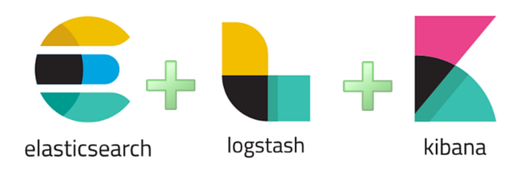
ELK
ELK is an acronym. Each letter stands for an open-source technology:
(elastic.co)
‹#›

Slide 11



Elastic Stack
These tools are collectively known as ELK stack.
Search and analytics engine.
Server-side data processing pipeline that sends data Elasticsearch.
Tool for visualizing Elasticsearch data with charts and graphs.
‹#›

Slide 12
ELK
Elasticsearch
ELK started with Elasticsearch.
It was initially designed to handle any kind of information. This means that logs and arbitrary file formats, such as PCAPs, can be easily stored and saved.
(elastic.co)
‹#›

Slide 13
ELK
Logstash
After Elasticsearch became popular for logging, Logstash was added to make it easier to save logs from different machines into the Elasticsearch database.
Logstash also processes logs before saving them, to ensure data from multiple sources has the same format before it is added to the database.
(elastic.co)
‹#›

Slide 14
ELK
Kibana
Since Elasticsearch can store so much data, analysts often use visualizations to better understand the data at a glance.
Kibana is designed to make it easy to visualize massive amounts of data in Elasticsearch.
Kibana is known for its complex dashboards.
(elastic.co)
‹#›

Slide 15
The Beats Family

Slide 16
Beats
The ELK stack works by storing log data in Elasticsearch with the help of Logstash.
While functional, this approach is not ideal because it requires administrators to collect all data reported by tools like syslog, even if they only need a small portion of it.
For example: Administrators often need to monitor changes to specific files, such as /etc/passwd, or track specific information, such as a machine's uptime.
In cases like this, it is wasteful to collect all of the machine's log data in order to only inspect a fraction of it.

Slide 17

Beats
Recently, ELK addressed this issue by adding an additional tool to its data collection suite, called Beats.
Beats are special-purpose data collection modules. Rather than collecting all a machine's log data, Beats allow you to collect only the very specific pieces you’re interested in.
ELK officially supports eight Beats. We will use two of them in this project:
Filebeat collects data about the file system.
Metricbeat collects machine metrics, such as uptime.
beats
elastic.co/beats/

Slide 18
Project Overview

Slide 19
Now it’s time to begin deploying.
Make sure you’re logged into your personal Azure account, not your cyberxsecurity account.
‹#›
‹#›

Slide 20
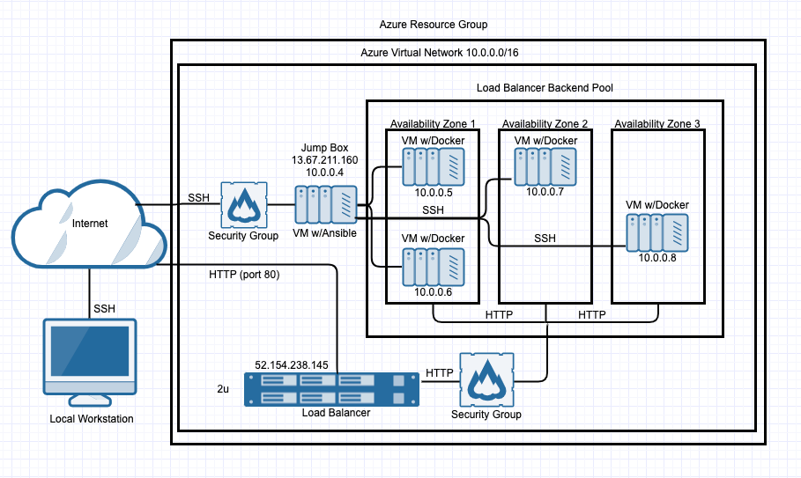
Project Setup
We’ll continue to build off the cloud week architecture.
This network has:
A gateway: the jump box configured during the cloud week.
Three additional VMs: one configuring the others, and two functioning as load-balanced web servers.

Slide 21

Project Milestones
Day 1: Configure the ELK server.
Day 2: Install Filebeat and Metricbeat.
Day 3: Finish leftover work, and create a network diagram and documentation.
‹#›

Slide 22
Configure the ELK Server
The rest of today will consist of the following:
Create a VM. Deploy a new VM onto the network to host the ELK server.
Download and configure the container. Download and configure the elk-docker container on the new VM.
Launch and expose the container. Launch the elk-docker container to start the ELK server.
Implement identity and access management. Configure your preexisting security group so you can connect to ELK via HTTP and view it through the browser.

Slide 23
Day 1 Activity: ELK Installation
For the remainder of class, you will work on the ELK installation, configuration, launch.
Full Class Time

Slide 24
Time’s Up
By the end of this class, you should have completed the following:
Deployed a new VM on your virtual network.
Created an Ansible play to install and configure an ELK instance.
Restricted access to the new server.
Completing these steps required you to leverage your systems administration, virtualization, cloud, and automation skills. This is an impressive set of tools to have in your toolkit.

Slide 25
Day 2: Filebeat

Slide 26
You completed installing the ELK server and will now install data collection tools called Beats.
If you have not completed all Day 1 activities, you can continue working on those tasks.
‹#›
‹#›

Slide 27
Filebeat
Filebeat helps generate and organize log files to send to Logstash and Elasticsearch. Specifically, it logs information about the file system, including which files have changed and when.
Filebeat is often used to collect log files from very specific files, such as those generated by Apache, Microsoft Azure tools, the Nginx web server, and MySQL databases.
Since Filebeat is built to collect data about specific files on remote machines, it must be installed on the VMs you want to monitor.
FILEBEAT
(elastic.co)
‹#›

Slide 28
Day 2 Activity: Filebeat and Metricbeat
Today, you will install Filebeat on the DVWA container you created during the cloud week.
This will provide a rich source of logs when you complete you deployment.
If you have time, you can also install Metricbeat.
Full Class Time

Slide 29
Time’s Up
By the end of this class, your ELK server should be receiving logs. You have:
Installed and launched Docker containers to a host machine.
Configured and deployed an ELK server.
Installed Filebeat on a Linux server.
(Completing the Metricbeat installation was a similar process.)

Slide 30
Day 3:
Exploration, Diagramming and Documentation

Slide 31
In the final day of the project, you will use Kibana to navigate logs. Then, you will have the option to create a network diagram, complete a README to document the information of the project, answer interview-style questions about your project, or further explore Kibana’s capabilities.
‹#›
‹#›

Slide 32
Exploring Kibana

Slide 33
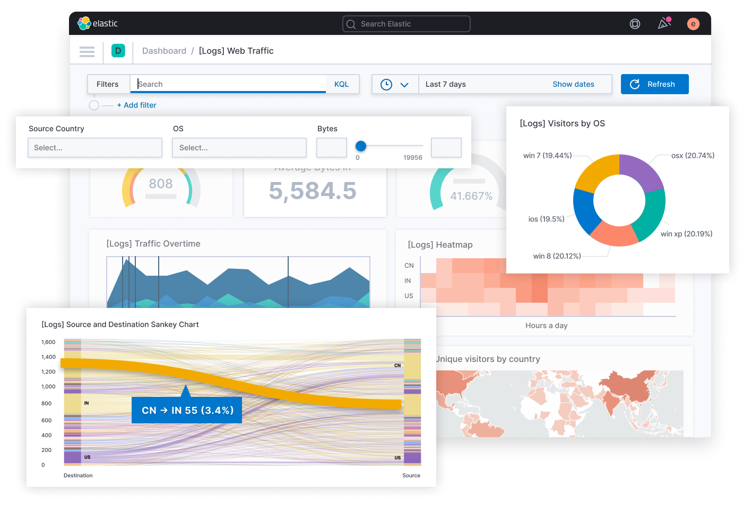
Kibana
Companies use tools like Kibana to research events that have happened on their network
Any attack leaves a trace that can be followed and investigated using logs.
Kibana is an interface to view and gain insight from that type of data that would other be unmanageable.

Slide 34
Kibana Walkthrough

Slide 35
Exploring Kibana
In this activity, you will use Kibana to explore web servers logs and analyze packet data for potential issues
0:25

Slide 37
Project Communication:
Documenting, Diagramming and Discussions

Slide 38

Along with the GitHub repository you will complete for
homework, the project documentation and diagram will
be valuable deliverables to show employers,
proving knowledge and experience.

Slide 39

Domain-Specific Interview Responses
Along with providing the visual deliverables, you should also be able to
verbally communicate the work you did on your project in order to
address specific interview questions or to show
your skills within a specific domain.
In this section, we will introduce an optional section of the project in which you will answer mock interview questions about your project and how they relate to various security domains.
Notes:
shutterstock_656504470

Slide 40
Mock Interview Questions
Over the next two classes, we will cover the following career prep skills that will help you get interviews and land jobs:
First, we will look at the general structure you can use when answering common technical interview questions. We will look at examples that use this general structure and also use specific examples from Project 1.
Then, you will answer questions about your project as they relate to security domains that align with your career interests.
Notes:
shutterstock_656504470

Slide 41
Responding to Technical Questions
In this section, we will walk through the process of
answering technical interview questions.
01
Restate the Problem
02
Provide a Concrete Example Scenario
03
Explain the Solution Requirements
04
Explain the Solution Details
05
Identify Advantages/Disadvantages of the Solution
Notes:
shutterstock_656504470

Slide 42
Sample Question
“How would you control access to a cloud network?”
01
Restate the Problem
When restating the question in your own words, add additional details to demonstrate you understand what is being asked and why.
Example: “It's important that organizations control access to a cloud network, especially since it has resources that only the engineering team should be able to access. In the interest of the Principle of Least Privilege, you want to make sure engineers can access it easily, but no one else can.”

Slide 43
Sample Question
“How would you control access to a cloud network?”
02
Provide a Concrete Example Scenario
Use the parameters of the question to create an example scenario of the problem you just restated. This makes the problem easier to talk through and further demonstrates your experience with the topic.
Example: “In Project 1 of my Cybersecurity boot camp, we solved an almost identical problem. In that project, we deployed a virtual network containing several VMs to Azure, which only we and our instructional team were supposed to be able to access. Just as an organization would limit cloud network access to only engineers, we had to implement remote access controls limiting access to only a handful of authorized individuals.”

Slide 44
Sample Question
“How would you control access to a cloud network?”
03
Explain the Solution Requirements
Before explaining the details of your solution, explain the high level actions taken at each step and explain what they accomplished.
Example: “After deploying the network, I first had to configure a Network Security Group (NSG) around the whole subnet. This blocked traffic from all IP addresses, except for mine, my partners', and my instructors'. This NSG allowed inbound access to only one machine on the internal network, called the Jump Box. Then, I configured additional NSGs on the VMs within the subnet. This allowed connections only between the jump box and other local IP addresses. Finally, I forced the use of SSH keys to eliminate vulnerability to password-based brute-force.”

Slide 45
Sample Question
“How would you control access to a cloud network?”
04
Identify Advantages and Disadvantages
Point out why your solution works in general. Then acknowledge any potential shortcomings and how you would address them..
Example: “This solution worked well for my project because it ensured only the selected users have access. However, it is difficult to maintain and scale because it requires updating the NSG every time a new user requires access to the network. In addition, securely using SSH keys can be tricky in the long-run. An alternative solution that addresses these shortcomings would be implementing a VPN gateway to the private network. This would allow us to manage and monitor users more safely and scalably.”

Slide 46
Sample Question
“How would you control access to a cloud network?”
05
Explain the Solution Details
Now that you laid out the high level steps and reflected on the pros and cons, use this time to explain the specifics of how you would implement the solution. The examples below are abbreviated for brevity, but real answers would typically include considerably more detail.
Example: “To configure access controls around the entire subnet, I created an NSG with the following ruleset: [Omitted…] These rules allow access to the jump box from only the specified IP addresses specified. Then, to configure access controls within the subnet, I created NSGs with the following ruleset: […] These rules allow the VMs within the network to communicate only with each other and with the jump box. To force the use of SSH keys, I modified the following configurations in the VMs on the network: [...] This ensures that password brute-force attacks will always fail.

Slide 47
Your Turn: Project Communication and Further Exploration
For the rest of the allotted project time, you will have the ability to focus on any of the following activities:
Finalize the network diagram you began during the cloud security week.
Draft a README explaining what you've built.
Answer mock interview questions.
Continue exploring Kibana’s features.

Slide 48
Day 3 Activity: Project Communication and Further Exploration
You will be provided four supplemental activity files.
Additional Kibana Exploration
Network Diagram (Part of homework)
Project Readme (Part of Homework)
Interview Responses
Remaining Class Time

Slide 49
Homework
Create a GitHub repository where you will save your project files and the README. You can use this repo to easily share the following with colleagues and employers:
Network diagram
Description of the deployment
Tables specifying access policies and network addresses
Usage instructions

Slide 50

Don’t forget to power off your machine!
Navigate to portal.azure.com.
Search for and select Virtual Machines.
Select every VM in the list.
Click Stop. This will ensure you’re not charged for any of the machines used in the project.

